Slide 1

Slide 1
Money Laundering Classification
-Harshit Singh

Slide 2
Slide 10
To design a model that must effectively handle data imbalance, provide real-time detection capabilities, and comply with regulatory standards to ensure that suspicious transactions are identified with minimal false positives, thereby enhancing the institution's anti-money laundering (AML) efforts.
Problem Statement
10

Slide 3
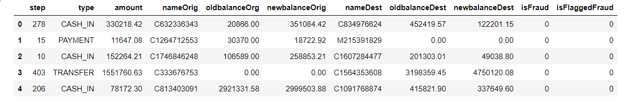
Slide 10
About
Data
The Number of Rows :75,000
The Number of Columns :11
10

Slide 4
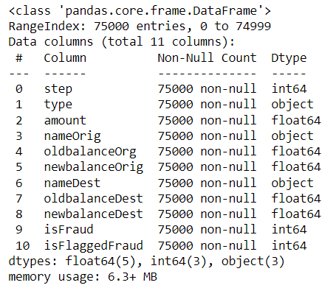
Slide 10
Data
Info.
10

Slide 5
Slide 10
Handling Nominal Columns
Column “Type” – Converted to integer by replacing values with 0,1,2,3
Column "nameOrig","nameDest"– Both the columns are dropped
EDA
10

Slide 6
Slide 10
3. Dropping highly correlated columns
Column “oldbalanceOrg” and “newbalanceOrig” were highly correlated – Column “oldbalanceOrg” was dropped
Column "oldbalanceDest","newbalanceDest “ were highly correlated - Column “oldbalanceOrg” was dropped
EDA
4. Handling Duplicate rows
Duplicate rows were dropped
10

Slide 7
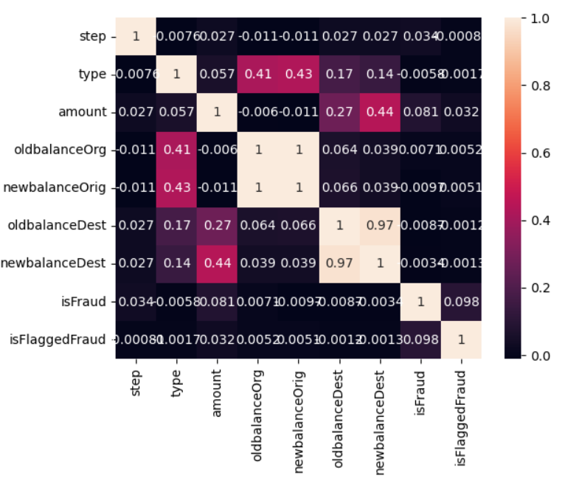
Slide 10
2. Checking Correlation among the feature
EDA
10

Slide 8

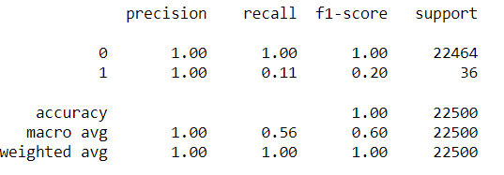
Slide 7
1. Random Forest
35%
Parameters:
max_depth=5
n_estimators=150
Classification Report
43%
Modelling

Slide 9
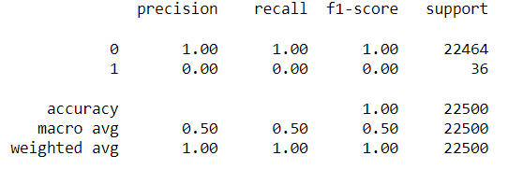
Slide 7
2. KNN
35%
Parameter:
n_neighbors=9
Classification Report
43%
Modelling

Slide 10
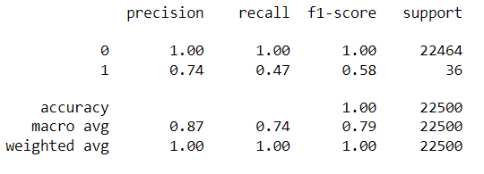
Slide 7
3. Ada Boost
35%
Parameter:
n_estimators=200
Classification Report
43%
Modelling

Slide 11
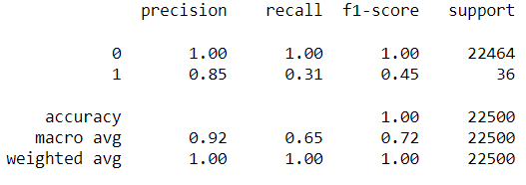
Slide 7
4. Gradient Boosting
35%
Parameter:
n_estimators=500
max_depth=2
Classification Report
43%
Modelling

Slide 12
Slide 7
Best Model
35%
Based on the Performance measure:
Best model to predict the Fraud is Gradient Boosting based on the
Precision to predict the fraud which is 0.85
Classification Report
43%
Result

Slide 13
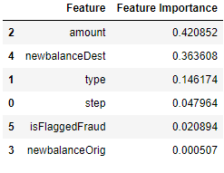
Slide 7
Feature Importance
35%
Important Features:
Amount
New Balance Destination
43%
Inference

Slide 14
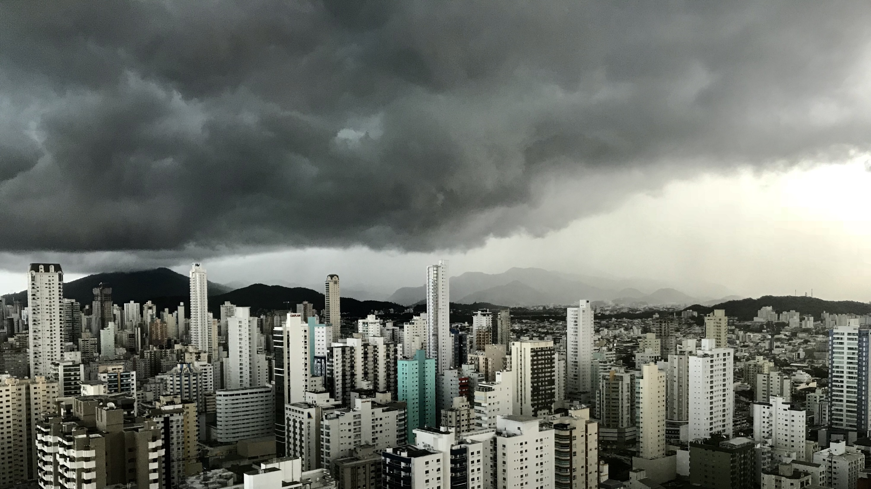
Slide 11
THANK YOU

